Slide 1
Image encryption and decryption
Information security lab
Submitted by: under the guidance of
Anya rathi Shariq murtuza
Vaishali Ranjan
Dhruv Gupta
Siddhant singh

Slide 2
ABSTRACT
This project on Encryption and Decryption of Image is based on Java platform.
The project consists of two concepts namely Encryption and Decryption.
ENCRYPTION: In this part of project, the image to be secured is entered by the user and converted into another form which is difficult to understand so as to felicitate data security.
DECRYPTION: In this part of project, the encrypted data needs to be decrypted i.e. broken down into original form so as to enable data usage.

Slide 3
Introduction
In the current trends, the technologies have been advanced. Most of the individuals prefer using the internet as the primary medium to transfer data from one end to another across the internet. There are many possible ways to transmit data using the internet like: via e-mails, sending text and images, etc. In the present communication world, images are widely in use.

Slide 4
Problem statement
The purpose of this project is to provide effective image data encryption with the aim of resisting statistical attacks and data breaches. This will enable the communicating parties to exchange sensitive data without leaking the data.

Slide 5
MOtivation
As digital images play an important role in multimedia technology, it becomes more important for the user’s to maintain privacy. And to provide such security and privacy to the user, image encryption and decryption is very important to protect from any unauthorised user access. Providing security to the users so that no one can access the image which is in the open network.

Slide 6
objective
The model for encryption and decryption of an image is designed with the following objectives:
For transmission of the image based on data as well as storage it should have confidentiality and security by using a suitable key.
To study the architecture of the image file.
The main objective of this image encryption method is to obtain a top quality hidden image in order to keep information secret.
Many factors have to be considered in order to develop the application such as processing speed of image, the strength of encryption result and ease of use to end users.

Slide 7
methodology
Get the image to be encrypted from the user by displaying a GUI for the user to select an image from its system , Processing a deciphered image for the receiver on key.
The image is basically encrypted and decrypted using a private key that the user has to provide.
For decrypting an image, We input the key from the receiver and generate the original image only in case the key matches.

Slide 8
Applications/features
Creating a Strong Encrypting image so that it cannot be hacked easily.
Perfection in the original image obtained after decrypting the original image.
Maintaining an individual’s privacy, especially on social media platforms
Image encryption has applications in the corporate world, health care, medical images, military operations, and multimedia systems.

Slide 9
SCOPE OF THE PROJECT
The scope of our project is presently specific. All the users who want to interact electronically, whether it is through emails, e-commerce, etc. through internet in order to keep their private information confidential.

Slide 10
TOOLS AND TECHNOLOGIES

Slide 11
Tools and technologies used
Software Requirement
Operating System – Windows 10/11
Language and frameworks - Java
IDE – Eclipse
Hardware Requirements:
Processor – 11th Gen Intel(R) Core ™ i5-1135G7 @2.40GHz 2.42 GHz
Installed RAM – 16GB
System Type – 64 Bit Operating System, x64 based processor

Slide 12
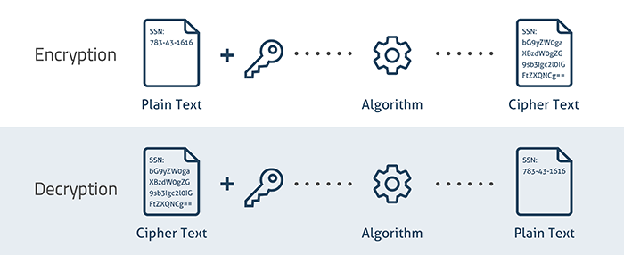
DESIGN OF PROJECT

Slide 13
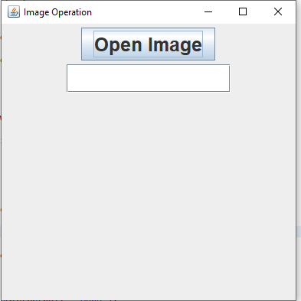
SCREENSHOT AND EXPLANATION
Here the user chooses an image to encrypt and decrypt.

Slide 14
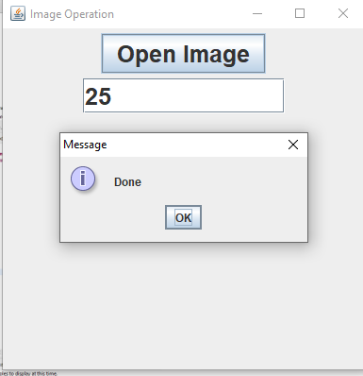
SCREENSHOT AND EXPLANATION
User inputs the key which is both used at the time for encryption as well as decryption.

Slide 15

SCREENSHOT AND EXPLANATION
Here the picture has been decrypted using the key.

Slide 16
Conclusion
The image encryption and decryption algorithm is designed and implemented to provide confidentiality and security in transmission of the image.

Slide 17
REFERENCES
[1] https://www.iosrjournals.org/
[2] https://www.researchgate.net/
[3] https://www.citeseerx.ist.psu.edu/
[4] https://www.ijser.org/

Slide 18
Thank you

